Slide 1
IBM University Engagement Project Submission
“Exploring the Power of Agentic AI with IBM Granite and LangFlow”

Slide 2
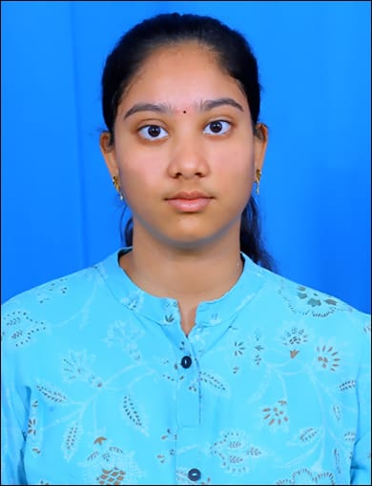
Project Tile – College Admission Agent ( RAG Based )
Domain of Project – Education
Student Name | Recent Passport Photo | Email ID | Mobile number [WhatsApp]
GADAMSHETTI SROVARSHINI |  | gadamshettiv@gmail.com | +91 8074567163

Slide 3
Problem Statement -
Problem Statement - College Admission Agent ( RAG Based )
The Challenge - A College Admission Agent, powered by RAG (Retrieval-Augmented Generation), streamlines the student admission process. It retrieves and summarizes admission policies, eligibility criteria, and FAQs from institutional databases and official sources. Prospective students can ask natural language questions and receive accurate, up-to-date responses instantly. The agent helps with course selection, application guidance, fee structure, and important deadlines. Using trusted, real-time data, it reduces manual inquiries and enhances applicant experience. This AI-driven assistant boosts transparency, accessibility, and efficiency in college admissions.
Technology - Use of IBM cloud lite services /IBM Granite is mandatory.
Objectives – College Admission Agent (RAG Based)
Develop an AI-powered admission assistant using IBM Granite
Provide accurate answers using Retrieval-Augmented Generation (RAG)
Retrieve key information like eligibility, fees, and deadlines
Deliver instant responses and reduce manual workload
Improve transparency and user experience in admissions
Assist students in course selection and application guidance

Slide 4
Technology Used
Tech Stack (Mandatory)
Use any one of the following approaches:
IBM Orchestrate + IBM watsonx.ai + Granite Models
IBM Cloud Agentic Lab with IBM Granite Models
Replicate with LangChain + RAG + IBM Granite Models
I used IBM Orchestrate + IBM watsonx.ai + Granite Models

Slide 5
Proposed Solution -
Proposed Solution: AI-Powered College Admission Agent
The proposed solution is an AI-powered College Admission Agent built using IBM Orchestrate, IBM watsonx.ai, and Granite Models to provide accurate, real-time admission guidance. The system addresses challenges in handling student queries, understanding admission criteria, and simplifying the application process through an intelligent, modular architecture.
At its core, the solution uses a Retrieval-Augmented Generation (RAG) pipeline to fetch reliable information from institutional sources such as admission brochures, eligibility documents, fee structures, and FAQs. This data is embedded and stored in a vector database, enabling the system to retrieve and generate precise, context-aware responses using Granite models.
The system consists of four key agents: Admission Knowledge Agent retrieves and summarizes admission-related information using RAG. Course Recommendation Agent suggests suitable programs based on student interests, eligibility, and academic background. Application Guidance Agent provides step-by-step support for form filling, document submission, and deadlines. Query & Support Agent handles real-time student queries and provides instant, accurate responses.
The solution includes a user-friendly chat interface (built with Streamlit or React) that allows seamless interaction.IBM Orchestrate the agent workflows, while watsonx.ai ensures scalable deployment, embeddings, and AI governance. Granite models power reasoning, summarization, and personalization.
Overall, this solution delivers an end-to-end intelligent admission assistant that enhances transparency, reduces manual workload, and improves the overall student experience.

Slide 6
Component Used -
1) Chat Input – Interface where students enter queries such as course details, eligibility, fees, admission deadlines, and required documents
2) IBM watsonx AI Agent - Processes user queries using Granite models and generates intelligent, context-aware responses for admission-related questions.
3) Name of IBM Granite model - Granite-4.0-8B-Instruct → Fast, efficient for like eligibility checks, course suggestions, and FAQs.
4) Chat output -Displays AI-generated responses such as:
Course recommendations
Admission procedures
Eligibility criteria
Fee structure details
5) File component Stores and manages:
Admission documents (PDFs, brochures, policies)
Course details and eligibility rules
Historical queries and FAQs Used for retrieval and continuous learning.
6) RAG (Retrieval-Augmented Generation) Component Retrieves relevant information from:
Admission brochures
Prospectus documents
Fee structure files
FAQs database Ensures accurate and up-to-date responses.

Slide 7
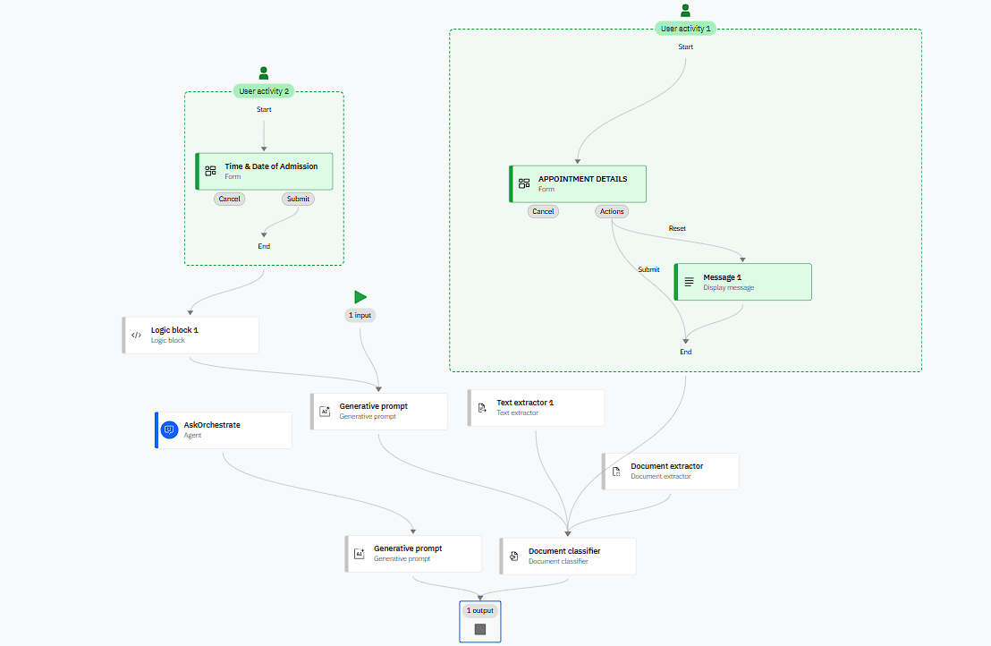
Workflow of Orchestrate
.

Slide 8
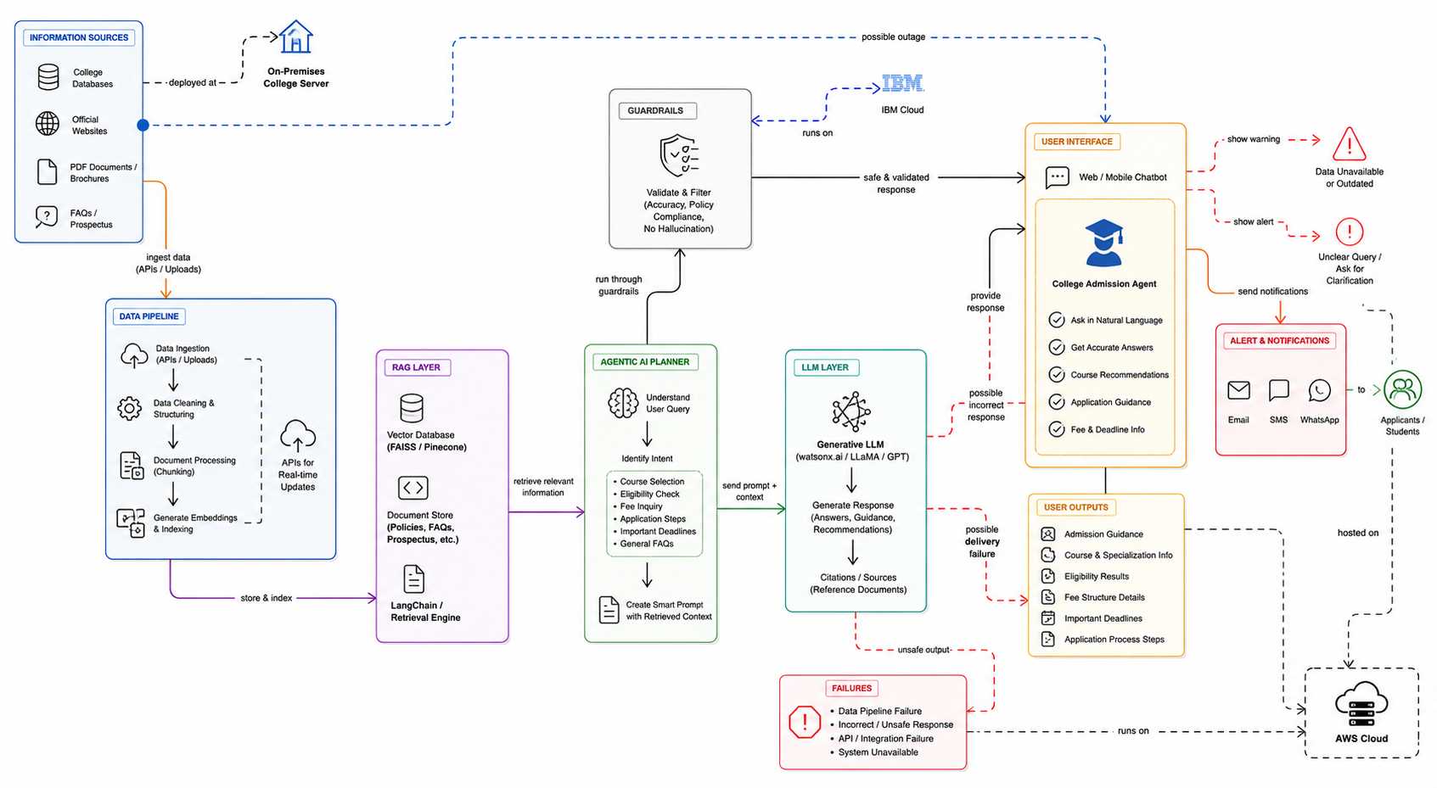
Architecture blueprint

Slide 9
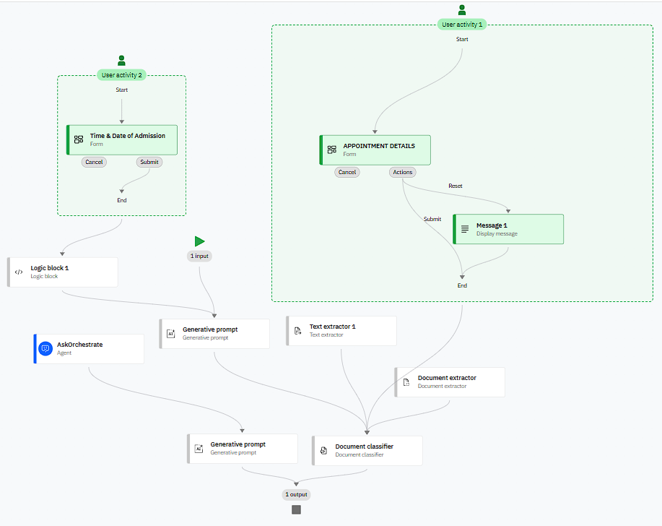
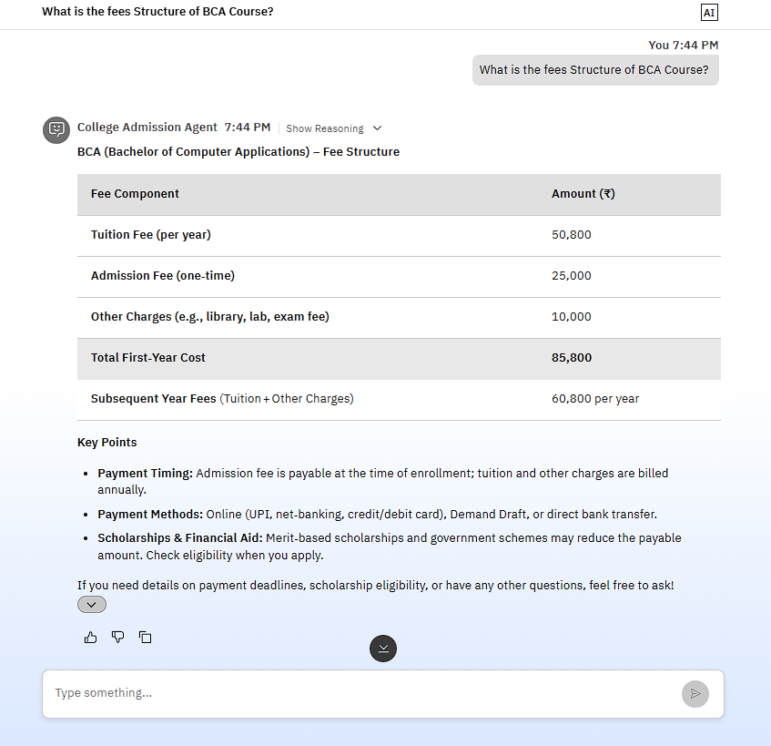
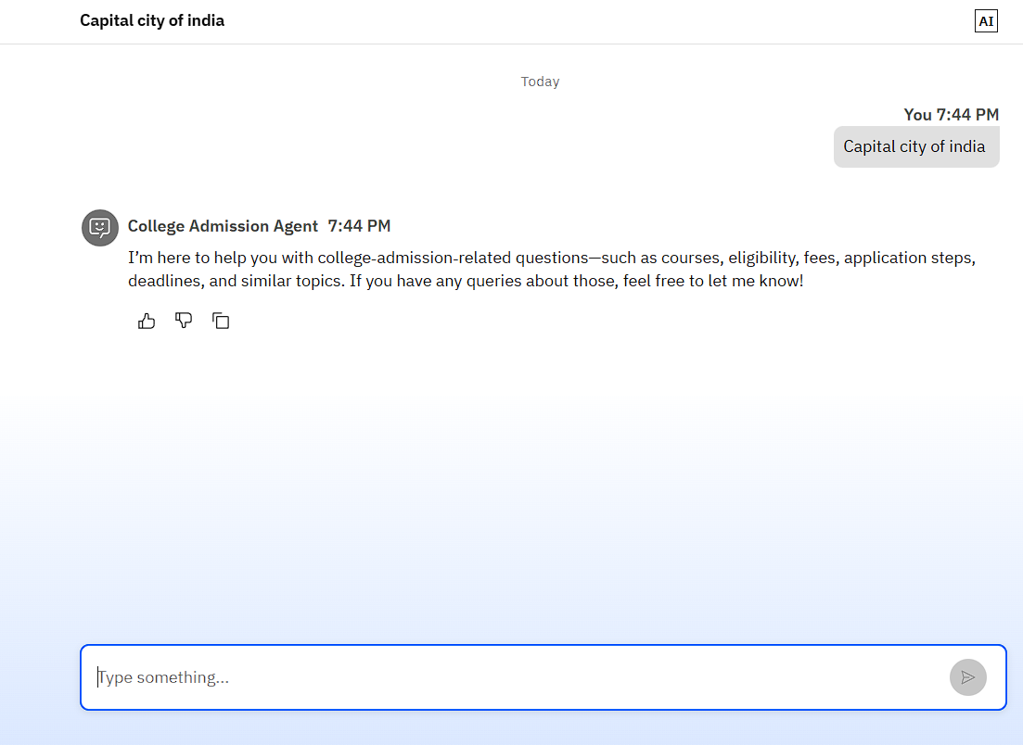
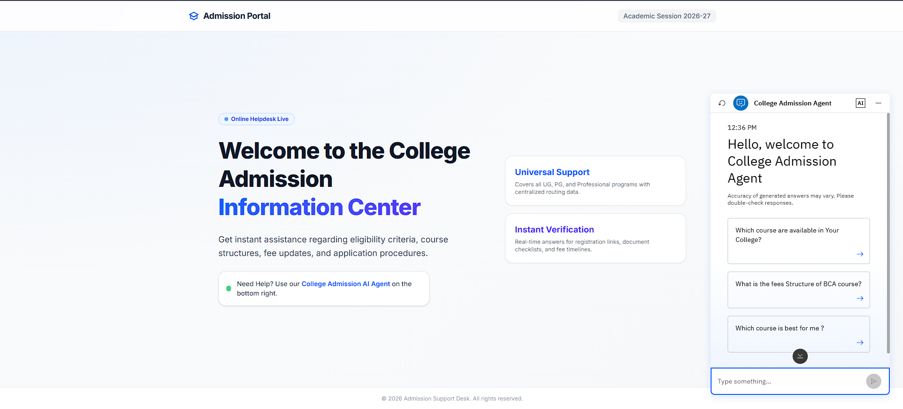
> WorkFlow of Agent in IBM Orchestrate
> Output based on user Prompt
> Agent responding only for college related queries
User Interface of Agentic AI in web
This agent helps with Course selection, Application Guidance ,Fee structure , Appointments and important headlines using trusted real time data it reduces manual enquiries and analysis applicant experience.

Slide 10

Role of Agentic AI in the solution
Role of Agentic AI in College Admission Agent (RAG Based)
Agentic AI enables the College Admission Agent to function as an intelligent, autonomous system rather than a simple chatbot. Using IBM watsonx.ai and IBM Granite models, it coordinates multiple specialized agents to deliver accurate and personalized admission guidance.
Each agent performs a specific role—such as retrieving admission policies, eligibility criteria, fee structures, course details, and important deadlines—while working collaboratively. This multi-agent approach ensures efficient query handling and accurate, context-aware responses.
Agentic AI also brings context awareness, understanding user details like academic background, interests, and career goals to generate relevant course suggestions and admission guidance. It supports real-time adaptation, continuously updating information from official sources to provide the latest admission updates.
Additionally, agents communicate with each other, enabling better decision-making and improved student experience.
Overall, Agentic AI makes the system proactive, transparent, and goal-driven, acting like a smart admission assistant that helps students make informed decisions and simplifies the entire admission process.

Slide 11
Technology Used
• IBM Watsonx Orchestrate – Used to design and manage the AI agent workflow and automate admission-related tasks
• IBM Granite Model – GPT-OSS 120B — OpenAI (via Groq)– For understanding student queries and generating accurate responses
• IBM Cloud – Provides a secure and scalable platform to deploy the admission agent
• RAG (Retrieval-Augmented Generation) – Fetches real admission data first, then generates reliable answers
• IBM Watsonx.ai – Used for model deployment, embeddings, and AI services
• Vector Database (FAISS/Chroma) – Stores and retrieves admission-related data efficiently

Slide 12
Novelty and Uniqueness
The proposed College Admission Agent stands out by combining Agentic AI, RAG, and personalization into a single intelligent admission assistant.
Multi-Agent Intelligence – Instead of a single chatbot, specialized agents handle queries like eligibility, course selection, and application guidance for more accurate responses.
RAG-Based Accuracy – Integrates real-time retrieval from college databases, policies, and FAQs with AI generation, ensuring reliable and up-to-date information.
Personalized Guidance – Recommends courses and colleges based on student interests, academic background, and career goals.
Real-Time Query Handling – Instantly answers student questions about fees, deadlines, and admission procedures without manual intervention.
Multi-Modal Interaction – Supports text and voice-based queries, making it accessible to a wider range of users.
End-to-End Admission Support – Assists with eligibility checks, document requirements, application steps, and deadline reminders.
Scalable & Enterprise-Ready – Built on modern AI platforms like IBM watsonx.ai, ensuring performance, reliability, and governance.
This makes the solution a smart, interactive, and proactive admission assistant, not just a basic FAQ chatbot.

Slide 13
Git Hub Link
· Please create public github repository (Enable Add README button while creating repository) with format –
Please test and Paste the working Github URL –https://github.com/GadamShettiSriVarshini/college-Admission-Agent.git
Make sure you have Uploaded following three files into your github repository 1) app.json file , 2) yourproblemstatement.pdf file 3) your projectpresntation.pptx file 4)any other files
·
·
·

Slide 14
Future Scope
1.Integration with Student Data Systems – The system can be integrated with academic databases and student information systems to access real-time data such as previous academic records, entrance scores, and eligibility status. This enables the Admission Agent to provide more accurate and personalized course recommendations and admission guidance based on individual student profiles.
2.AI-Powered Chatbot & Multilingual Support – Enhancing the system with a conversational chatbot and multilingual capabilities will improve accessibility. Students can interact naturally in their preferred language, making the admission process more inclusive and user-friendly, especially for applicants from diverse linguistic backgrounds.
·
·
·

Slide 15


